Slide 1
Spheres &
Hypersphères
A paradigm for explaining the structure of the Hypersphere

Slide 2
The sphere as a paradigm for the 3D hypersphere
Notations: Let be an N-dimensional space (Euclidean, for example) with a "Cartesian" basis of N linearly independent vectors, centered at a point O of this space, supporting "Cartesian" coordinates.
3-dimensional case (N = 3)
In 3D: coordinates (x, y, z), we call the 3D sphere the place of points such as x²+y²+z² ≤ R², where R, which is a constant, is the radius of the sphere. The location of points such as x²+y²+z² = R² is the N-1 dimensional hypersurface, in this case a 2-dimensional hypersphere, which delimits an interior and an exterior of the 3-dimensional sphere.
This generalizes to N dimensions.

Slide 3
The sphere as a paradigm for the 3D hypersphere
Following Plato, for whom the paradigm is the study of a simple example to facilitate the study of a complex case, of the same structure, the 3-dimensional sphere and its surface (2D hypersphere, commonly called "spherical surface") is the paradigm for studying and understanding the 4D sphere and its surface (the 3D hypersphere) whose representation is not obvious.
Indeed, the 2-dimensional surface of the 3D sphere, which we know well, which is a Riemannian manifold with maximum symmetry (homogeneous and isotropic) generalizes to the 3D hypersphere (homogeneous and isotropic) which delimits a 4-dimensional sphere.

Slide 4
Hypersphere definition
Let's start with a 4-dimensional sphere. (4-Sphere) volume: 1/2 π²R⁴, where R is the (constant) radius of the 4-sphere. In 4-dimensional Euclidean space, with the coordinates u, x, y, z, the relation:
u² + x² +y² + z² = R²
defines, in this 4D space, the boundary between the inside and the outside of the 4-sphere, this boundary is a 3D hypersurface called the hypersphere, with a volume of 2 π² R³.
Note that it is much higher than the volume of the 3-sphere (4πR³/3)
If: u² + x² +y² + z² ≤ R², this is the inside of the 4-sphere. If: u² + x² +y² + z² > R² , this is the outside of the 4-sphere.

Slide 5

Calculating the surface of the 3D sphere
$S=\int_{−π/2}^{π/2}{2πr.Rdθ}$= $\int_{−π/2}^{π/2}{2πRcosθ.Rdθ=2πR²\int_{−π/2}^{π/2}{cosθ.dθ}}$ $=2πR²{[Sinθ]}_{−π/2}^{π/2}$= $4πR²$
Note that the 2D surface may be achieved by stacking
, in a 3D space, the set of circles of radius r = R.cos$θ$
$for −π/2≤θ≤π/2$, (sphere slices) which are
the closed (1D) lines with maximum symmetry
Calculating the volume of the 3D sphere
This volume is generated by the spherical surface
S, in green, which increases from r = 0 up to r = R,
which sweeps the entire interior volume of the sphere.
$V=\int_{0}^{r}{4πr^{2}dr \text{=}4π{(\frac{r^{3}}{3})}_{0}^{R}}$= $\frac{4π}{3}$ R³
R
O’
r
dθ
M
O
θ
S

Slide 6
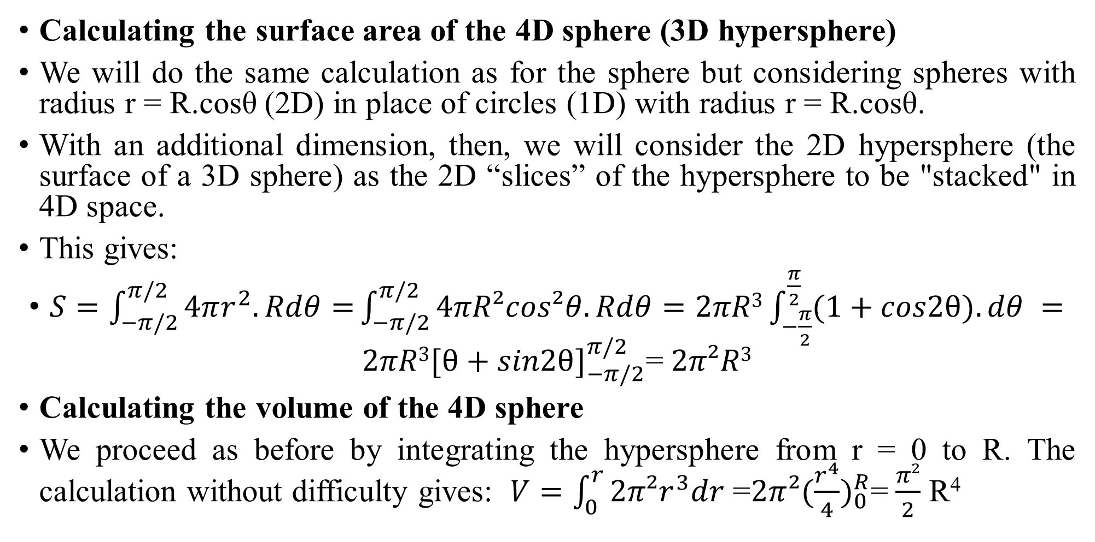
The sphere as a paradigm for the 3D hypersphere
Calculating the surface area of the 4D sphere (3D hypersphere)
We will do the same calculation as for the sphere but considering spheres with radius r = R.cosθ (2D) in place of circles (1D) with radius r = R.cosθ.
With an additional dimension, then, we will consider the 2D hypersphere (the surface of a 3D sphere) as the 2D “slices” of the hypersphere to be "stacked" in 4D space.
This gives:
$S=\int_{−π/2}^{π/2}{4πr^{2}.Rdθ=}\int_{−π/2}^{π/2}{4πR²cos²θ.Rdθ=2πR3\int_{−\frac{π}{2}}^{\frac{π}{2}}{(1+cos2θ).dθ} }=2πR3{[θ+sin2θ]}_{−π/2}^{π/2}$= $2π²R3$
Calculating the volume of the 4D sphere
We proceed as before by integrating the hypersphere from r = 0 to R. The calculation without difficulty gives: $V=\int_{0}^{r}{2π²r^{3}dr\text{ =}2π{²(\frac{r^{4}}{4})}_{0}^{R}}$= $\frac{π²}{2}$ R⁴

Slide 7
Hypersphere example in Robertson Walker metric (RW)
The RW metric results from the constraint that the spatial (3D) part of the metric of space-time (4D) metric is homogeneous and isotropic. It can be written:
ds²= -dt² +a²(t).[dr²/(1-kr²)+r²(dθ ²+sin²θ.dφ ²)] = -dt² +a²(t). dσ²
t, r, θ et φ , (spherical) coordinates with respect to the local observer , where r is the co-moving radial coordinate. This metric was determined without using Einstein's equation.
The parameter a(t) will be determined, by constraining the metric by Einstein's equation, by its value of the cosmological constant λ and the value of the energy-momentum tensor T_{μν} of the configuration. The result is the Friedmann and Lemaître (for λ ≠0) equations.

Slide 8
This dynamic metric, invariant by translation and rotation, but not by a Lorentz transformation, defines a manifold of type R*Σ with R set of reals (time), Σ manifold of type 3D space with maximum symmetry function of a(t) which is the scale factor that describes the temporal evolution of the universe and k is the curvature parameter that describes its spatial geometry:
Remember that there are 3 interesting cases: k = - 1, k = 0, and k = + 1.
We will consider a solution of Friedmann's equations for a universe consisting only of "dust" type matter, with a density greater than the critical density, (closed universes) which corresponds to k = +1.

Slide 9
In this case, the spatial geometry is a hypersphere (closed), we often define r = sinχ, to write the metric on Σ, which, then,becomes:
ds²= -dt² +a²(t). [dχ² + sin²χ(dθ ²+sin²θ.dφ ²)] = -dt² +a²(t). dσ²
dσ ² = dχ² + sin²χ.dΩ ², which is the metric of a hyperphere.
Where dΩ ² = dθ ²+sin²θ.dφ ², is the metric on a spherical (2D) surface.
The value of a(t) given by Friedmann's equations, in this case, is in parametric form and will be expressed by the following equations:

Slide 10
Solution for “overcritical" dusty universe: Closed Universes:
a = C/2 ( 1 - cos χ ) , t = C/2 (χ - sinχ) , for k = + 1 ,
where: C = (8πG/3).ρ.a3 = constant and where r = sinχ.
It is the equation of a cycloid. The "parametric" form shows that, not withstanding with the form of the metric, it is not the time but the angle of development χ which is the dynamic parameter in this case!
The following figure shows the dynamics when we travel through the hypersphere when χ varies from 0 to 2 π. This exhibits its structure: an "entanglement" of 2D spheres of increasing radius from a sphere of zero radius to "the largest 2D sphere" whose radius is that of the hypersphere, then decreasing to a zero radius in the 3D space of the hypersphere.

Slide 11
Sphere Paradigm (2D) for Hypersphere (3D)
When we travel on the sphere from the north pole to the south pole, 0 ≤ θ ≤ π, the sections of the sphere, at constant θ, are circles [1] whose radius varies from 0 at the north pole, to R at the equator, and then from R to zero at the south pole.
For the 3D hypersphere, it's the same principle, but the circles are replaced by spheres [2]
[1] Circles are objects of dimension 1 with maximum symmetry (homogeneous and isotropic)
[2] Same for spheres, but in 2D
North Pole: θ =0
θ =π/4
Equator: θ =π/2
θ =3π/4
South pole: θ =π

Slide 12

ds²= -dt² +a²(t).[dχ² + sin²χ(dθ ²+sin²θ.dφ ²)]
2a/C
The cycloid is a geodesic of the 3D hypersphere
Spherical surfaces: (2D hyperspheres)
χ= π
2
χ= π/2
χ= 3π/2
1
χ= 0
χ= 2π
0
(π/2)-1
π
(3π/2)+1
2π
2t/C
North Pole hypersphere 3D (dot)
Equator Hypersphere 3D: Large Sphere
South Pole 3D Hypersphere (dot)

Slide 13
Annex: The dynamic parameter of the solution
In the form of the metric of the solution considered,
ds²= -dt² +a²(t).[dχ² + sin²χ(dθ ²+sin²θ.dφ ²)]
We can see that the part in square brackets is the spatial metric of a hypersphere. Since the scaling factor a(t) is in the factor of this spatial metric, we expect a solution where this spatial section is a time-modulated hypersphere where t is the parameter of this scaling factor. This is not the case.
Note that the factor a(t) is not determined and that it is Friedmann's equation that will specify it. It turns out that the solution is parametric and that the parameters a(t) and t are functions of χ.
The result is that the space section is indeed a hypersphere, but is a fixed hypersphere and is not a function of time as expected, as one might have imagined.

Slide 14
Annex: The dynamic parameter of the solution
The dynamics of the solution are then given by the path on a geodesic on this fixed hypersphere and not the size of the hypersphere.
The case of De Sitter's space-time
One of the forms of the De Sitter metric of space is written:
ds²= -dt² +cosh²(t). [dχ² + sin²χ(dθ ²+sin²θ.dφ ²)]
We note the similarity with the previous case, but here the factor, a(t) = cosh(t), is determined, unlike the previous case.
Here the description of the spatial section is indeed a hypersphere which, starting from an infinite size at the infinity of the past, decreases down to a finite minimum size for t = 0 and grows up again towards infinity toward the infinity of the future.

Slide 15
Annex: The dynamic parameter of the solution
Some fundamental differences between the two solutions.
The de Sitter solution mentioned represents a space-time (4D) with maximum symmetry (10 symmetries). It can be established independently of general relativity on strictly geometric considerations.
If it satisfies Einstein's equation (solution of Friedmann's equations), is it a solution of general relativity?
We can debate it.
In the closed universe, made of matter that we have mentioned, the symmetry is less (6 symmetries), because it only involve the spatial section, so these solutions are structurally different. This closed universe made of matter requires Friedmann's equations, and therefore general relativity, to be established.

